Slide 1
Master-Thesis Methodical Approach for Analyzing Process Parameters and Optimizing Boundary Conditions in Mutli-Axis Robot Programs
Status Update: Week 07 (17 weeks left)
13.11.2023 – 19.11.2023
Jan Nalivaika

Slide 2
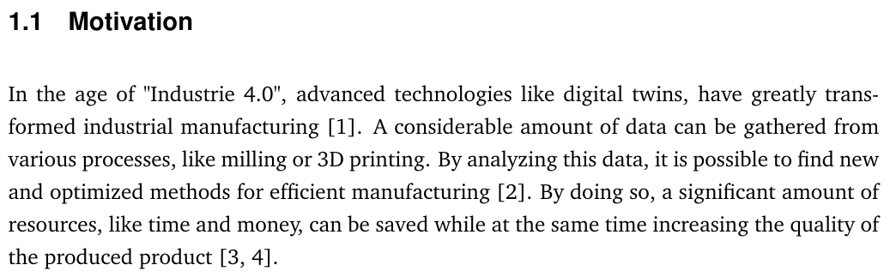
To-Do
- Stand der Technik (an Ludwig)
- Wichtige Prozess Parameter sortieren
- Nur wichtiges validieren
- Quellen nach Nummer sortieren
- Nächster Termin: 17.11.2023 wie geplant
- 24.11. ohne Ludwig -> kein Termin
Wichtiger Punkt für Methode:
Normieren? Skalierung? Für „Local Score“ Berechnung (ML for best case calculations – Oultook?)

Slide 3
Process Parameters
Constraints to the toolpath
- Tool orientation (rotation around C)
- Robot configuration (joint 3, joint 5 and the overhead) [“J3- J5+ OH-“] {Area of solution}
- Auxiliary axes (Rotor Tilt Table)
Avoiding collisions
Avoiding motion exceeding or close to the motion limits of each joint
Avoiding excessive axes acceleration, velocity, and direction changes
Orient the tool or workpiece such that cables are optimal (laser fibres, welding wire and filament extrusion)
Avoid poses, which are near singularities

Slide 4
Sort by VIP
Outlook: -> Stiffness value
-> Cycle time
-> Collision index
Angular position of each joint
Angular velocity of each joint
Angular acceleration of each
Angular jerk of each joint
Direction changes of each joint (same end-position: LVL 2 implem.)
Total travel of each joint
TCP coordinates (X-Y-Z)
TCP velocity in (X-Y-Z)
TCP acceleration in (X-Y-Z)
Continuous energy usage [IN DETAIL NEXT WEEK]
Total energy usage
(Near) Vertical material deposition
Reachability index (Cable entanglement) (Kabelvektor zur banane) [FOTO]
Singularity Analysis (J5 Gelenk) [FOTO]

Slide 5
Validation – Evaluation of a Toolpath – VERY SIMPLE MODEL!
Very Simple Tool Path made by hand
Example: Rising ellipse in 5 DoF
Set C Axis to random value
Industrial robot with 6 DoF
Inverse Kinematics
Analyze Joint angles
Get score

Slide 6
Validation – Evaluation of a Toolpath – VERY SIMPLE MODEL!
Very Simple Tool Path made by hand
Example: Rising ellipse in 5 DoF
Set C Axis to random value
Set Table Rotation and Tilt to random value
Industrial robot with 6 DoF
Inverse Kinematics
Analyze Joint angles
Get score

Slide 7
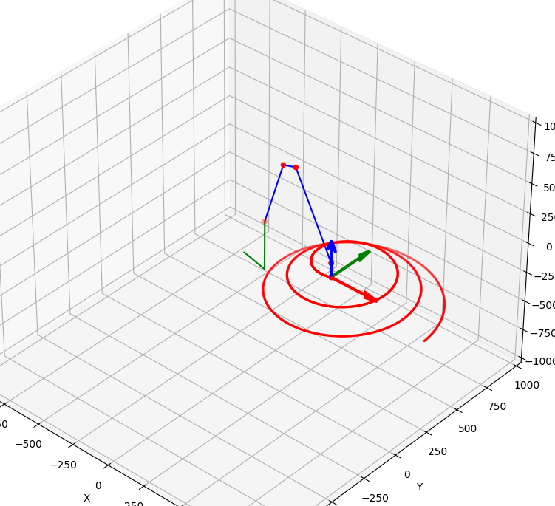
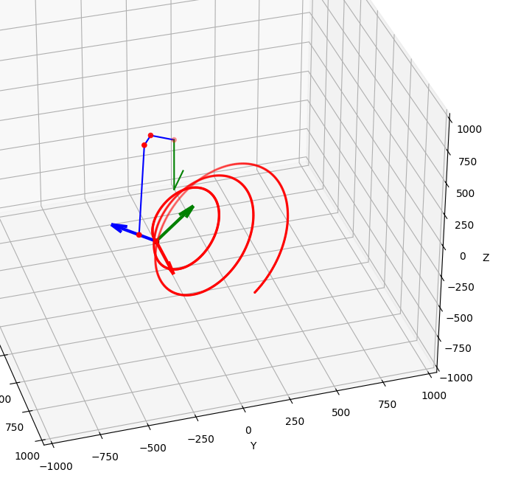
Code, Rotation around C + Tilting table

Slide 8
Validation on object – ONLY ANALYSIS
Joint angles v1
Joint angles v2
Joint angles v3
Joint angles v4
Joint angles v5
Joint angles v6
Joint angles v7
Joint angles v8
Joint angles v9
Siemens NX
Crazy STL object
Toolpath in 5 Dof
Set Random DoF 6/7/8
Analysis
Robot model
Problem: Can we automate in NX ??

Slide 9
Validation on object – Optimization
Siemens NX
Crazy STL object
Toolpath in 5 Dof
Set DoF 6
In NX
Joint angles
From NX
Analysis / Score
Robot model
Optimization algorithm
Problem: Can we automate in NX ??

Slide 10
Validation on object – Optimization
Siemens NX
Crazy STL object
Toolpath in 5 Dof
Set DoF 6
external
Inverse Kinematic
external
Robot model
Optimization algorithm
Analyze/Score
Give optimal DoF 6 to NX

Slide 11
To-Do / Other
NX Einarbeitung bis 1.12.2023
NX questions deadline 15.12.2023
Schriftart / Größe / Farbe bei Bildern

Slide 12
Contact
Jan Nalivaika (TUM) Student Otto-Hahn-Ring 6
81739 Munich, Germany
Phone +49 163 7180148
E-mail jan.nalivaika.ext@siemens.com nalivaika@outlook.de
Marius Breuer (Siemens AG)
Supervisor Otto-Hahn-Ring 6
81739 Munich, Germany
Phone +49 (172) 8396287
E-mail marius.breuer@siemens.com
Ludwig Siebert (TUM-IBW)
Supervisor Boltzmannstr. 15
85748 Garching at Munich
Phone +49 (89) 289 – 15578
E-mail ludwig.siebert@iwb.tum.de

Slide 13
State of the Art Questions
Continuous-path mode ???
Changes: -
-
-
-
G-Code ??
Add / No Add

